Slide 1
Linux Block IO: Introducing Multi-queue SSD Access on Multi-core Systems
Matias Bjorling, Jens Axboe, David Nellans, Philippe Bonnet

Slide 2
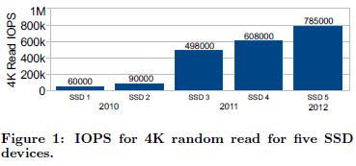
Motivation
SSDs are going to get faster, by increasing their internal parallelism
CPU performance will improve largely sue to the addition of more cores
The Linux block layer has become a bottleneck

Slide 3
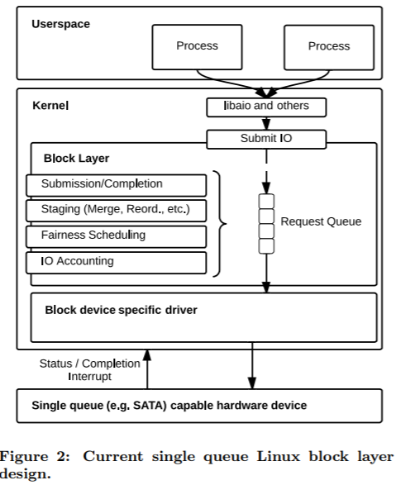
OS Block Layer - architecture

Slide 4
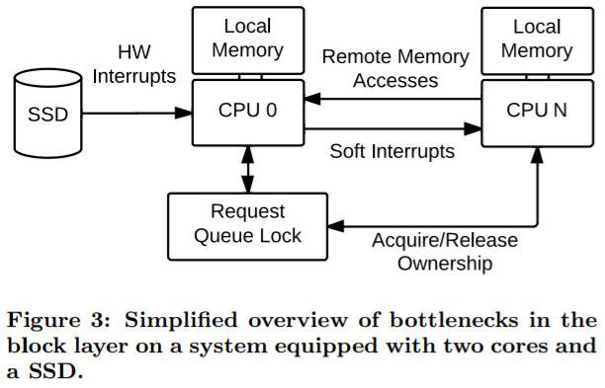
OS Block Layer - scalability
Request queue locking
Hardware interrupts
Remote memory accesses

Slide 5
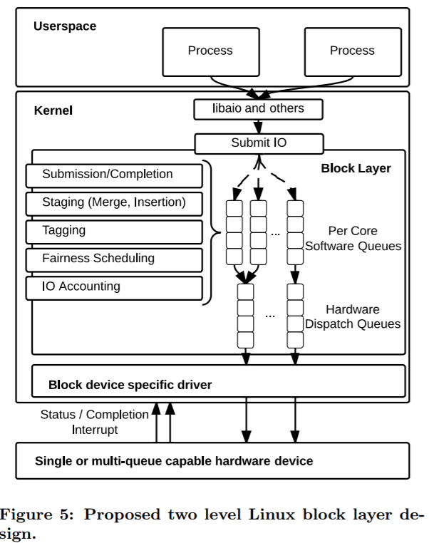
Multi-Queue Block layer - architecture
Software queues
Hardware dispatch queues
No remote access
IO-Scheduling → FIFO

Slide 6
Experiment
single queue design (SQ)
Multi queue design (MQ)
Bypass the Linux block layer (Raw)
Null device driver
For MQ, a software queue is associated to each core and a hardware dispatch queue is associated to each socket

Slide 7
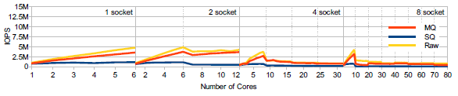
Experiment - throughput
With the single queue block layer implementation, throughput is limited below 1 million IOPS
The scalability of MQ and raw exhibits a sharp dip when the number of sockets if higher than 1

Slide 8
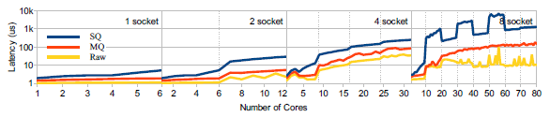
Experiment - latency
Remote memory accesses contribute to increase latency on multi-sockets systems

Slide 9
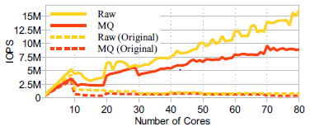
Improvement
Both the MQ and Raw implementations are able to scale IOPS near linearly up to the maximum number of cores within the system

Slide 10
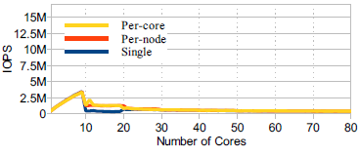
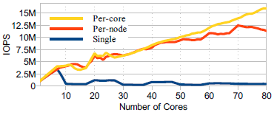
Allocation of queues
A single software queue - Sharp performance dip when the second socket is introduced
A software queue per core - Combining multiple software and hardware dispatch queues enable high performance

Slide 11
Conclusion
The current design of the Linux block layer does not scale beyond one million IOPS per device
Proposed a new design for the Linux block layer which based on two levels of queues in order to reduce contention and promote thread locality
This new multi-queue design leverages the new capabilities of NVMe, while still providing the common interface and convenience features of the block layer

